Slide 1
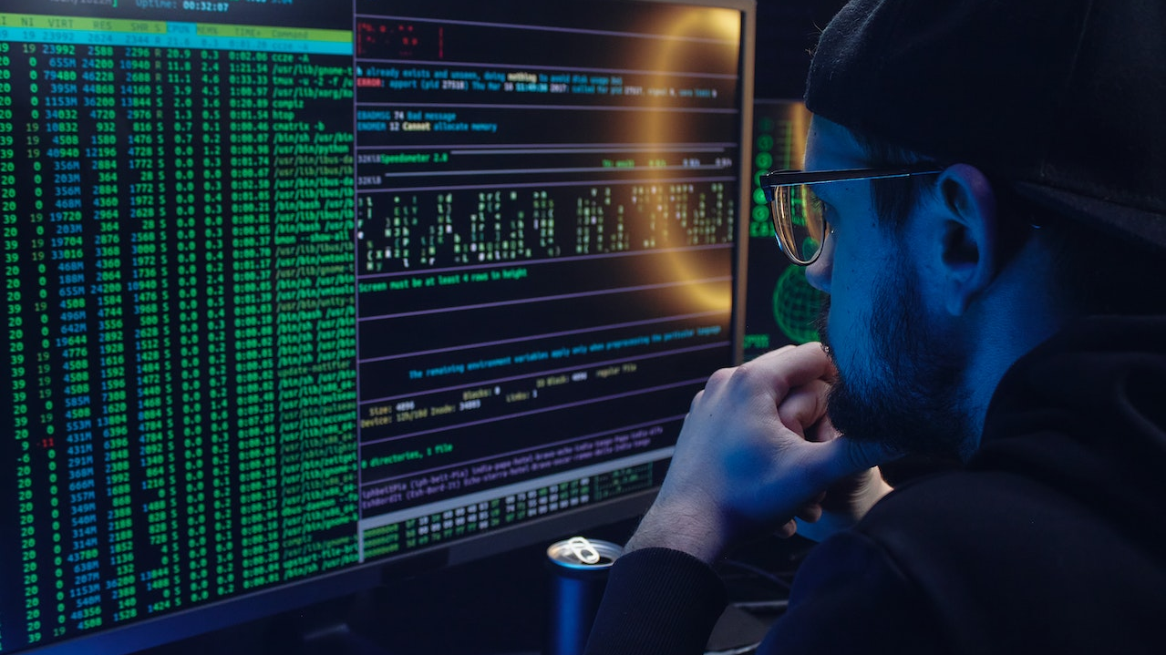
Point of Sale (POS)
JAVA
Made by Ajinkya Satkar
Project Co-Ordinator :- Junie Denny Solomon

Slide 2
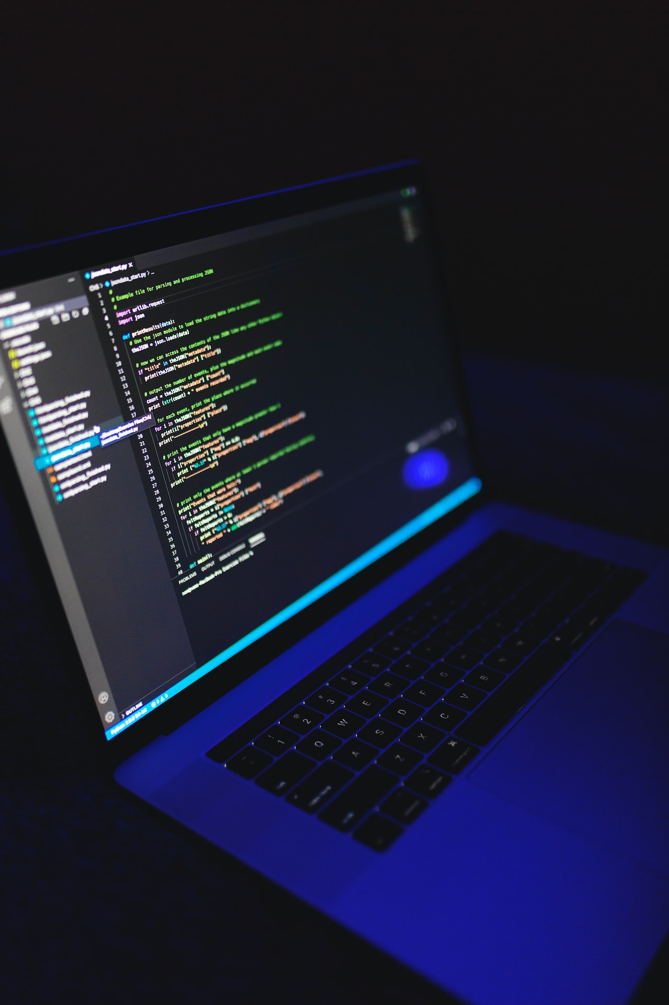
The Point Of Sale Java Code is the location where a consumer makes a payment for goods or services, as well as where sales taxes may be due.
It could be a physical store with POS terminals and systems for processing card payments, or a virtual sales point like a computer or mobile electronic device.
Point of Sale

Slide 3
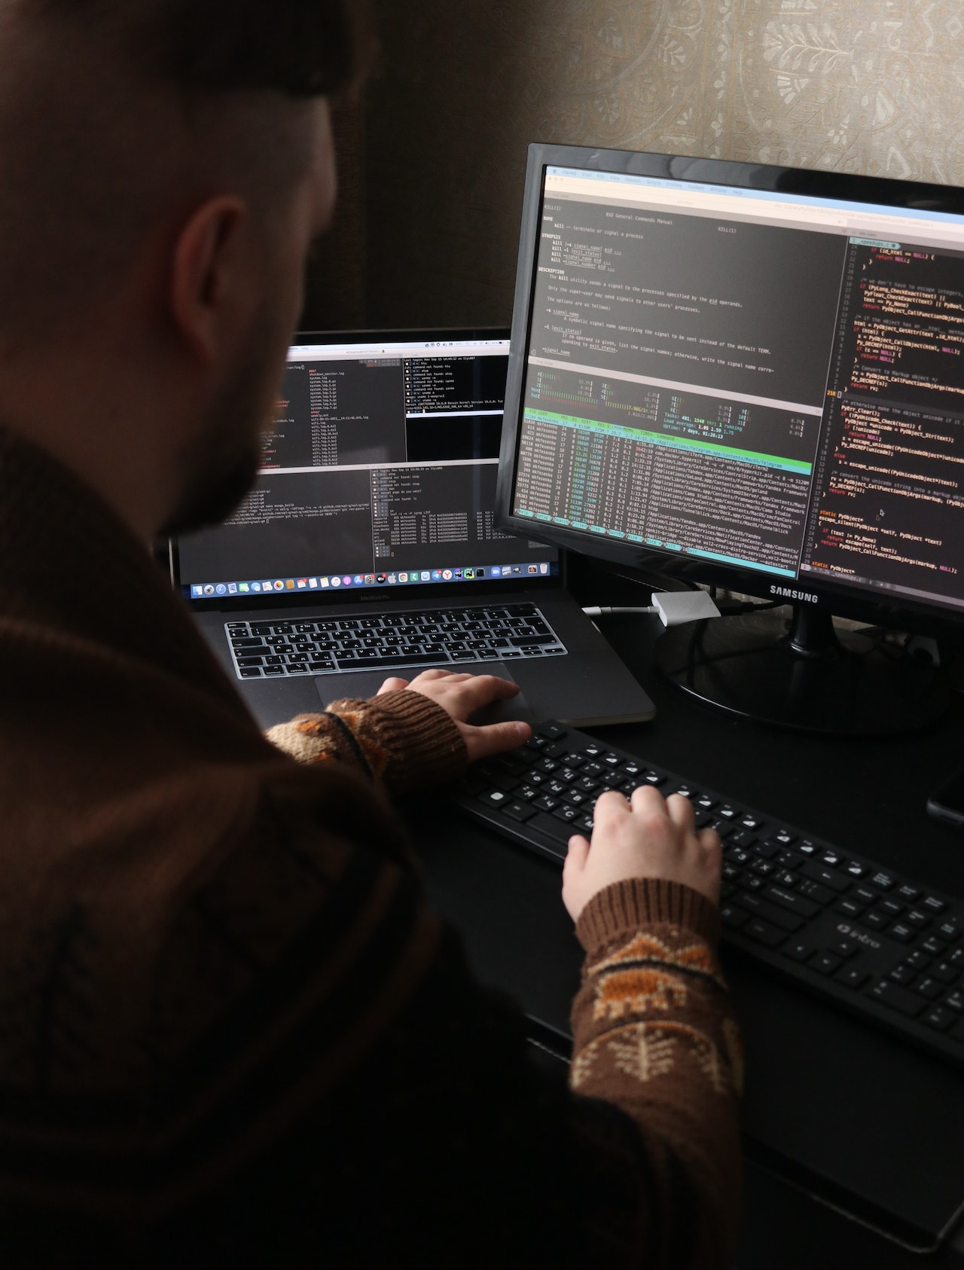
Objective
Implementing a point of sale client and back office server to support sales and transactions in a small company or restaurant/bar.
The program will be easy to use, reliable, and secure. It also will be fully customizable by the administrator. Customizable buttons, menus, and users.

Slide 4
Goals
The ability to have security, ease of use, and power over how they want the application to function will be our selling point.
Because of the quick employee turnover rate, our system will be different because the interface will fairly intuitive. It will be easy to use.

Slide 5
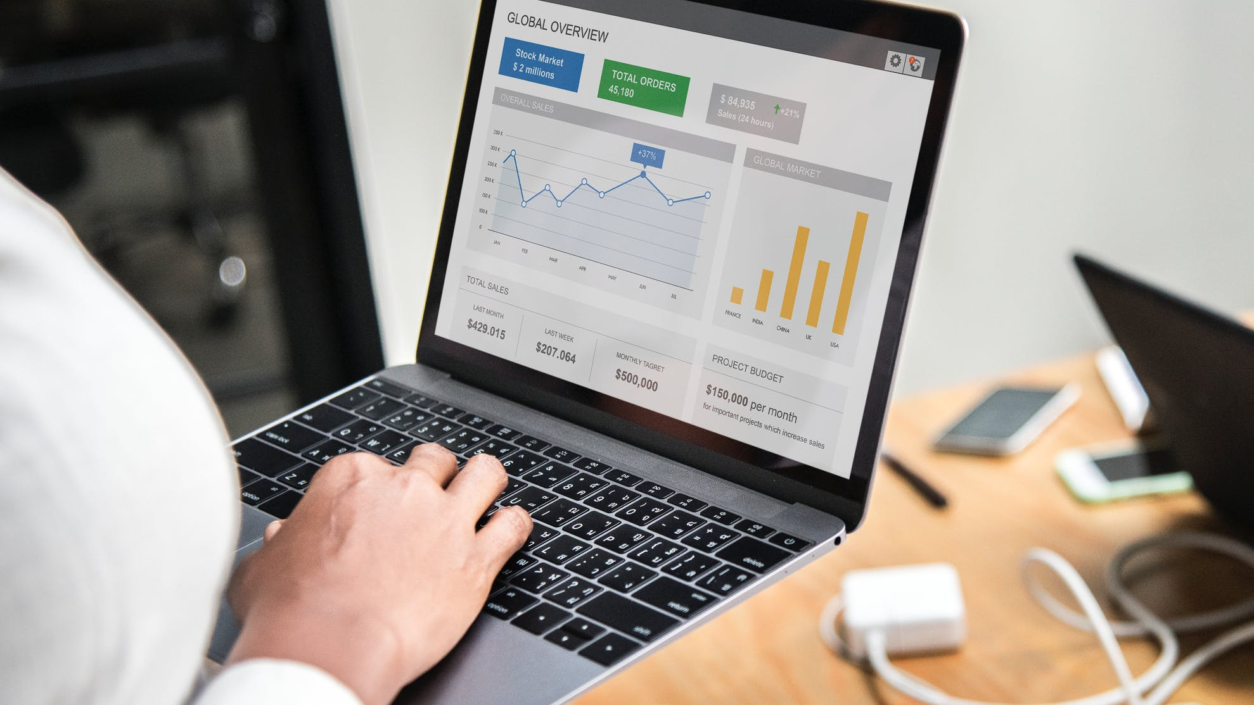
Clients:
Bars
Restaurants
Small Retail Shops
Users:
Waiters/Waitresses
Cashiers
Managers
Our Community

Slide 6
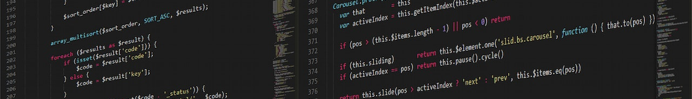
System Requirements
Back Office Server
Client Workstation
PDA’s (Optional)
Kitchen Display (Optional)

Slide 7
Back Office Server
We will be using as the bare minimum for the suite two computers. One running the back office server which can:
Add new items to the database. Give them prices and place them in appropriate menus so that the client machine can browse for the item, select with the press of a button.
Edit existing items in database: ie change prices, change descriptions.
Print single users, daily, weekly, monthly, and yearly reports. This feature gives the manager information on the day to day sales helping in planning and monitoring what sells and what doesn’t. Also can monitor transactions
Inventory. Can view inventory of items. Also can give an optional reminder if quantity of a certain item gets to a certain amount.
Add users to the system giving them unique login codes
Customer tracking: names, address, history

Slide 8
Client Workstation
Easy to use menus to browse and select items to include in an order or transaction.
Editablity At anytime the employee wants to change an order, he or she can select the item they want to edit and delete or modify it.
Option of scanning barcodes to ring things in
Option of entering a SKU number to ring things in as well.
GUI split into a 2 x 2 grid. Bottom right is the number pad to enter quantities, amount of money received from customer, and other helpful things.
Bottom left will include a summary of all items added to the transaction with quantities, prices, descriptions as well as a total before tax. The top will have a main menu and other useful crap.

Slide 9
PDA’s
An optional feature that can be brought to the table or around the store to take orders.
Same functionality as the terminal but portable

Slide 10
Kitchen Display
An optional feature
Only used to display orders

Slide 11
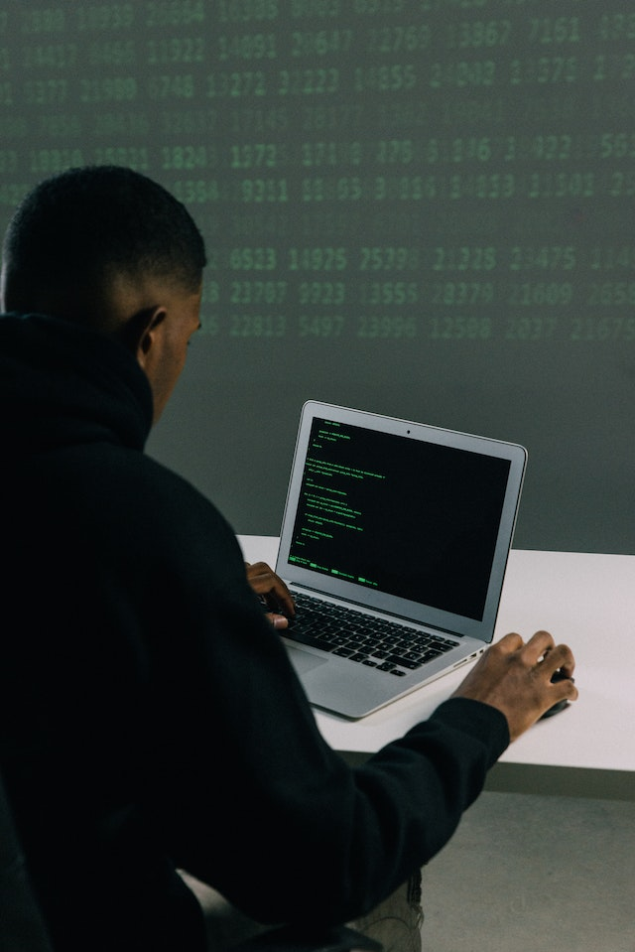
System/Software Architecture
Which language will be used for development?
What will be needed for the project?
I/O devices
Overall communication of the system

Slide 12
Development
Implemented in Java or C#
Advantages to Java
Virtual Machine allows options for different operating systems
Disadvantages to Java
GUI would be harder to implement
Advantages to C#
GUI would be easier to develop
Disadvantages to C#
Systems would have to run on a Windows machine

Slide 13
Input:
Bar code scanners and card readers
Risk: Is there support in the language for these devices?
Output:
Receipt Printer
I/O Devices

Slide 14
JFrame
JFrame is a class for creating top-level windows in Java's Swing GUI toolkit that display other graphical user interface components like buttons, labels, and text fields.
JFrame provides methods to create, manipulate, and arrange GUI components, handle events, and includes a menu bar.

Slide 15
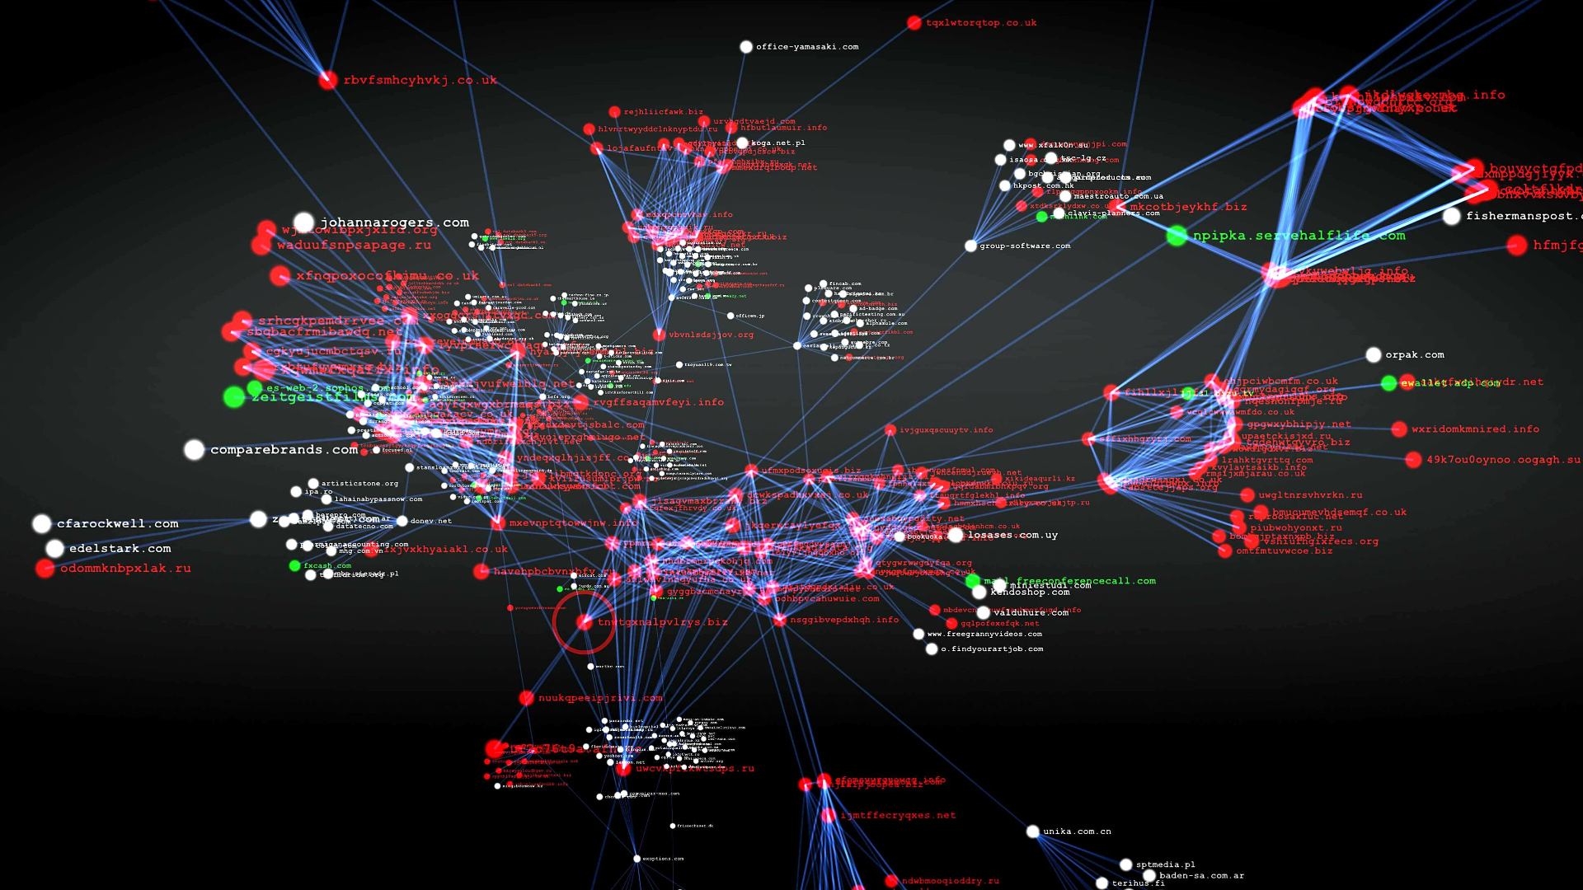
Overall Communication
The system will be linked using a wireless network
The wireless capabilities will allow for a diversity of building layouts and for the use of the PDA system.

Slide 16
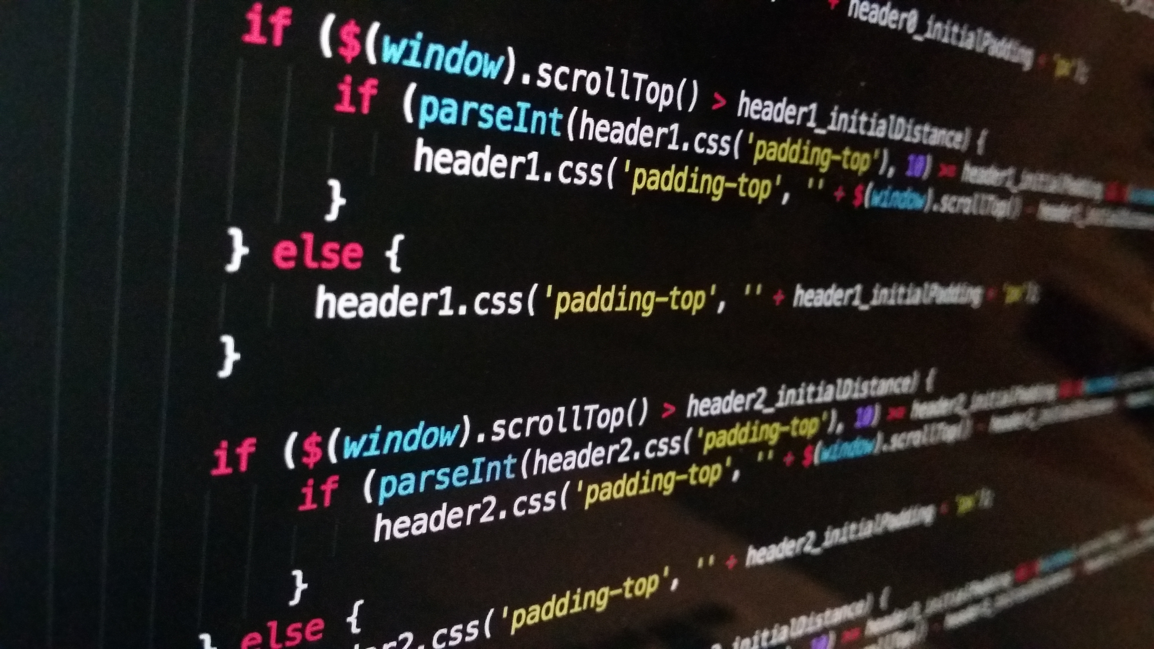
Assumptions
Java has support for input from barcode and scanners.
It will actually be easy to use.
Waiter/Waitresses will actually want to use PDA’s rather than traditional methods (i.e. using paper pads or remembering orders).

Slide 17
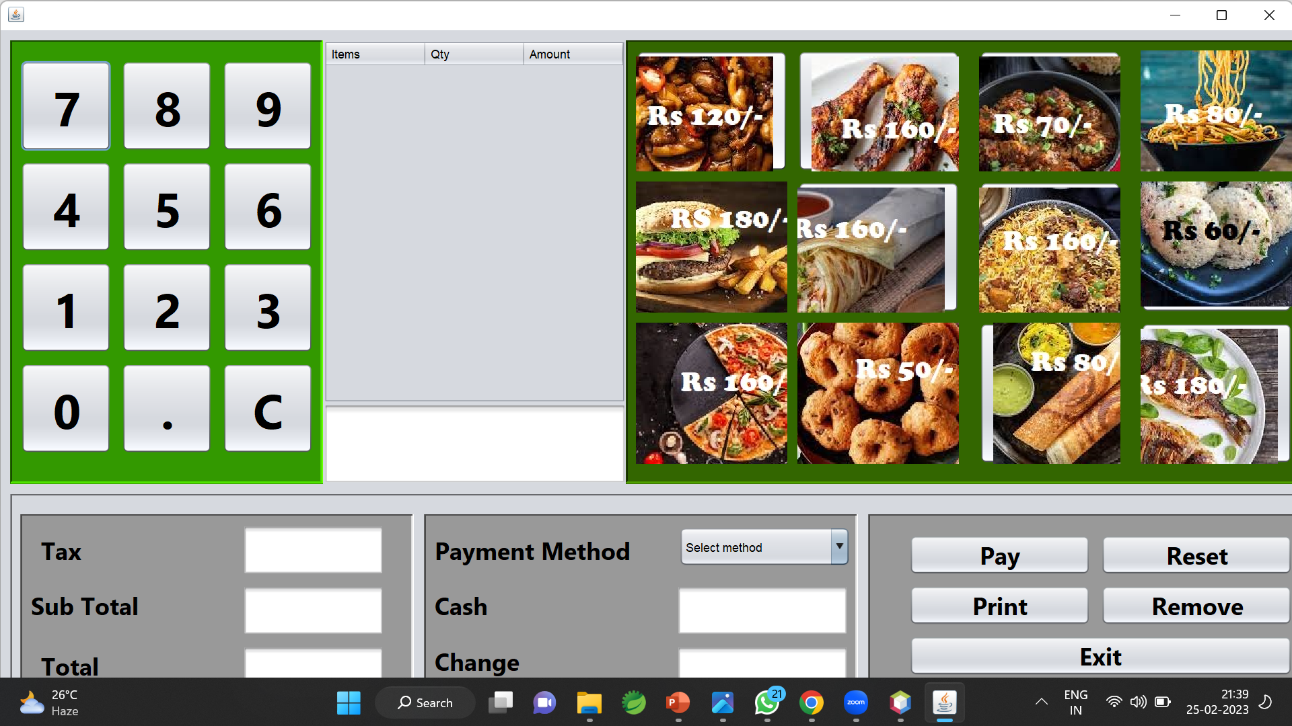
Project Review

Slide 18
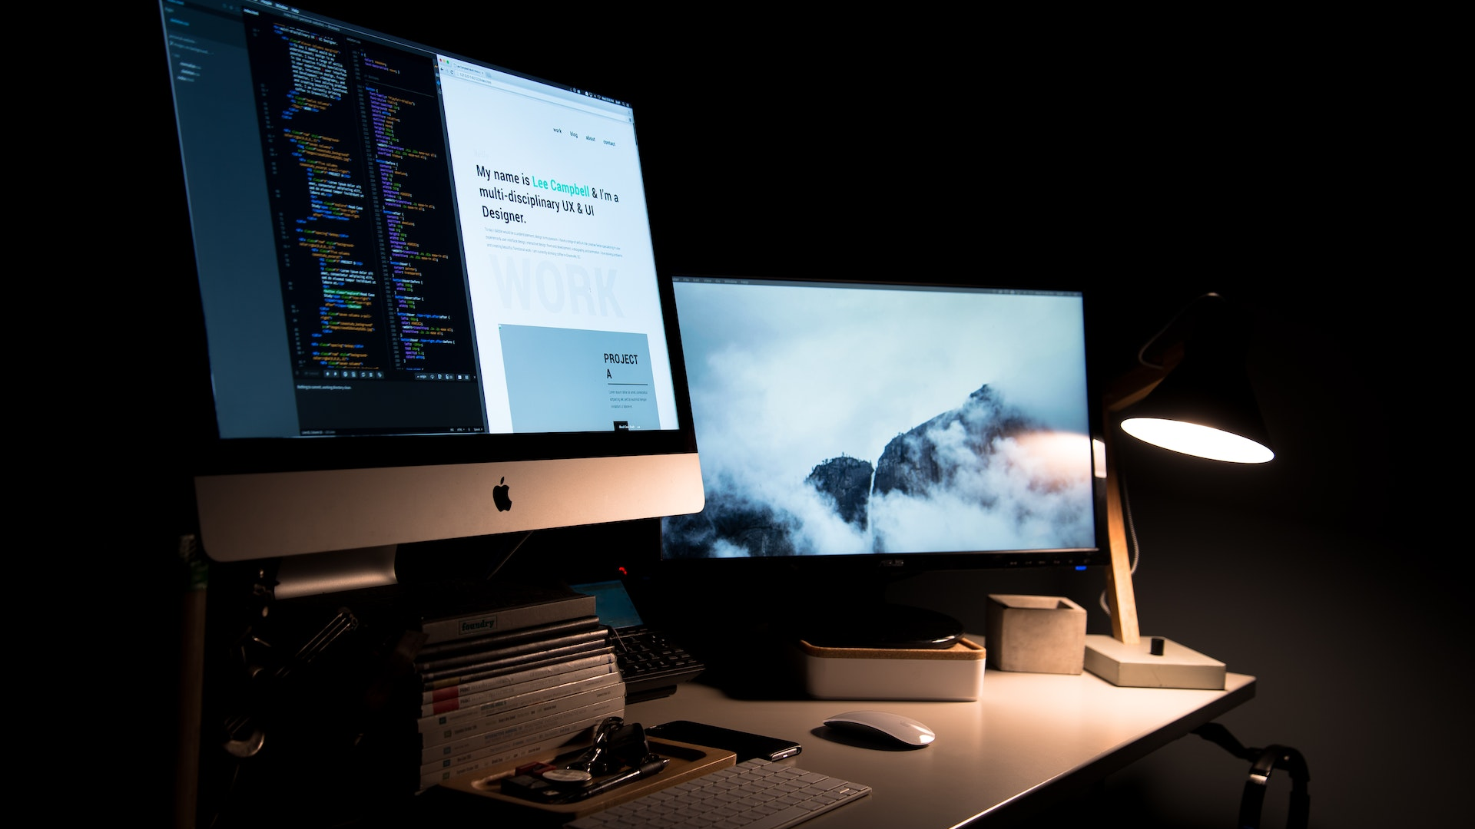
Thank You

